Slide 1

UNIT-2
CLASSIFICATION OF THE RESEARCH DESIGN

Slide 2

Chapter Outline
1) Overview
2) Research Design: Definition
3) Research Design: Classification
4) Exploratory Research
5) Descriptive Research
  Cross-Sectional Design
  Longitudinal Design
  Advantages and Disadvantages of Longitudinal and Cross-Sectional Designs
6) Causal Research
7) Relationships Among Exploratory, Descriptive and Causal Research

Slide 3
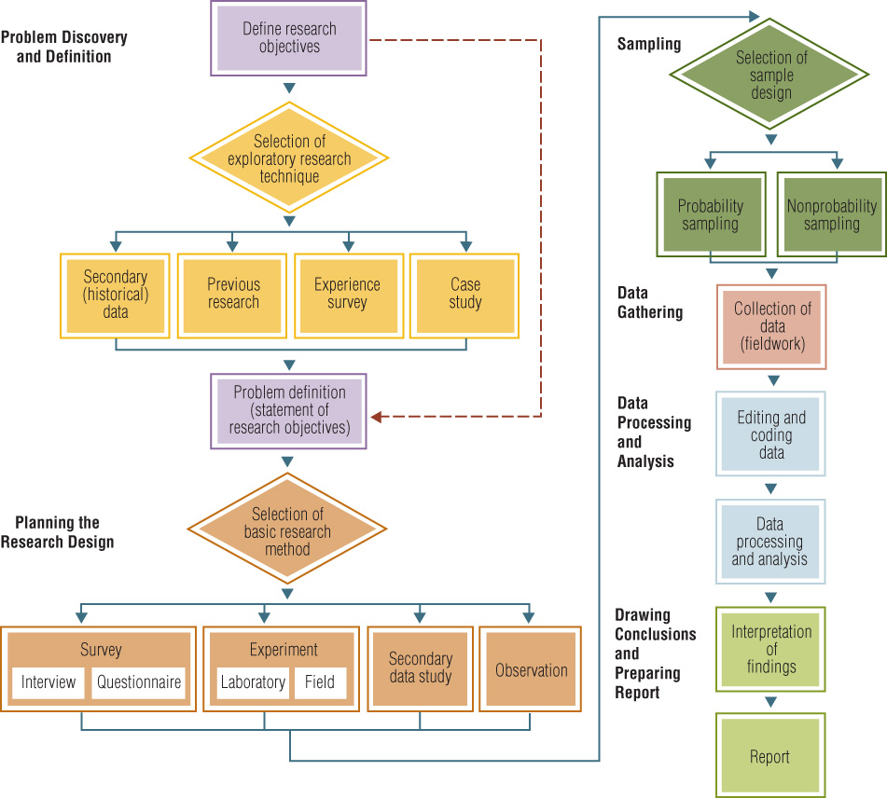
The Business Research Process

Slide 4
Research Design: Definition
A research design is a framework or blueprint for conducting the marketing research project.
It details the procedures necessary for obtaining the information needed to structure or solve marketing research problems.

Slide 5
Research Design
The research design needs
Clear objectives derived from the research question
To specify sources of data collection
To consider constraints and ethical issues
Valid reasons for your choice of design

Slide 6
Classification of the research purpose
Exploratory research
Descriptive studies
Explanatory studies
  Causal research - to identify cause and effect relationships (inferences).

Slide 7
Uncertainty Influences
The Type Of Research
CAUSAL OR
DESCRIPTIVE
COMPLETELY
CERTAIN
ABSOLUTE
AMBIGUITY
EXPLORATORY

Slide 8

A Classification of Marketing Research Designs
Research Design
Exploratory Research Design
Conclusive Research Design
Descriptive Research
Causal Research
Cross-Sectional Design
Longitudinal Design
Single Cross-Sectional Design
Multiple Cross-Sectional Design

Slide 9

Exploratory & Conclusive Research Differences
Table
Exploratory
Conclusive
Objective:
Character-istics:
Findings/ Results:
Outcome:
To provide insights and understanding
Information needed is defined only loosely. Research process is flexible and unstructured. Sample is small and non-representative. Analysis of primary data is qualitative
Tentative
Generally followed by further exploratory or conclusive research
To test specific hypotheses and examine relationships
Information needed is clearly defined. Research process is formal and structured. Sample is large and representative. Data analysis is quantitative
Conclusive
Findings used as input into decision making

Slide 10

A Comparison of Basic Research Designs
Table 3.2
Exploratory
Descriptive
Causal
Objective:
Characteristics:
Methods:
Discovery of ideas and insights
Flexible
Expert surveys
Pilot surveys
Case studies
Secondary data:
qualitative analysis
qualitative research
Describe market characteristics or functions
Marked by the prior formulation of specific hypotheses
Preplanned and structured design
Secondary data:
quantitative analysis
Surveys
Panels
Observation and other data
Determine cause and effect relationships
Manipulation of independent variables, effect on dependent variables
Control mediating variables
Experiments

Slide 11
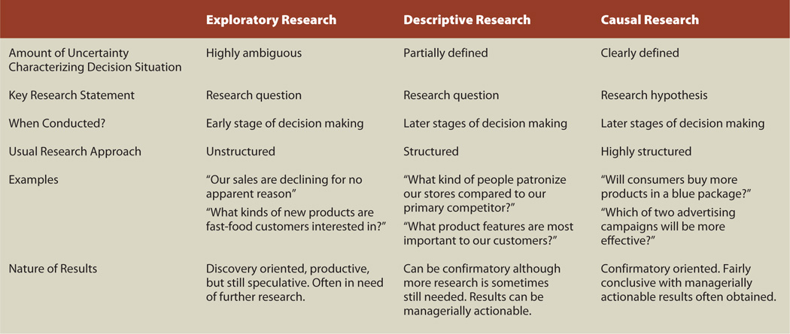
Characteristics of Different Types of Business Research
Uncertainty Influences the Type of Research Conducted

Slide 12
Exploratory
Exploratory is:
- to find out what is happening,
- to seek new insights,
- to ask questions
- to assess phenomena in a new light
Three principals to conduct exploratory research:
- a search of the literature
- interviewing ‘experts’ in the subject
- conducting focus group interviews

Slide 13
Classification of the research purpose
Exploratory Research:
undertaken with the aim of clarifying ambiguous problems
general problems usually known but not sufficiently understood
the purpose is to get more information, not to uncover specific courses of action (subsequent research)

Slide 14
Uses of Exploratory Research
Formulate a problem or define a problem more precisely
Identify alternative courses of action
Develop hypotheses
Isolate key variables and relationships for further examination
Gain insights for developing an approach to the problem
Establish priorities for further research

Slide 15
Methods of Exploratory Research
Survey of experts
Pilot surveys
Secondary data analyzed in a qualitative way
Qualitative research

Slide 16

Commonly Used
Exploratory Techniques
Secondary Data Analysis
Experience Surveys
Focus Groups

Slide 17
Descriptive
Descriptive is:
- the researcher observes and then describes what was observed.
- to portray an accurate profile of persons, events or situations.
- an extension of, or a forerunner to a exploratory/explanatory research

Slide 18
Classification of the research purpose
Descriptive Research:
undertaken with the aim of determining the characteristics of a population or phenomenon
Previous knowledge of problem exists
High degree of precision or accuracy required

Slide 19
Examples:
Who are the main consumers of organic foods?
How many students read the prescribed course literature?
Where do most holiday-makers travelling overseas go?
When do petrol stations tend to raise their prices?

Slide 20
Use of Descriptive Research
To describe the characteristics of relevant groups, such as consumers, salespeople, organizations, or market areas
To determine the perceptions of product characteristics
To determine the degree to which marketing variables are associated

Slide 21
Classification of the research purpose
Descriptive approaches should be used when:
You just want to describe what is happening in a particular situation.
When you do not want to test a formal hypothesis – for example you might want to do a survey of peoples attitudes or beliefs.

Slide 22
Methods of Descriptive Research
Secondary data analyzed in a quantitative, as opposed to a qualitative, manner
Surveys
Panels
Observational and other data

Slide 23

Descriptive Studies
Who?
How much?
What?
When?
Where?
6-<number>

Slide 24

Descriptive Studies
Descriptions of population characteristics
Estimates of frequency of characteristics
Discovery of associations among variables
Notes:
In contrast to exploratory studies, more formalized studies are typically structured with clearly stated hypotheses or investigative questions. Formal studies serve a variety of research objectives such as those listed in the slide.
The third objective, discovery of variable associations, is sometimes labeled a correlational study, which is a subset of descriptive studies. Correlation is the relationship by which two or more variables change together, such that systematic changes in one accompany systematic changes in the other.

Slide 25
Cross-Sectional Designs
Involve the collection of information from any given sample of population elements only once
In single cross-sectional designs, there is only one sample of respondents and information is obtained from this sample only once.
In multiple cross-sectional designs, there are two or more samples of respondents, and information from each sample is obtained only once. Often, information from different samples is obtained at different times.

Slide 26
Longitudinal Designs
A fixed sample (or samples) of population elements is measured repeatedly on the same variables
A longitudinal design differs from a cross-sectional design in that the sample or samples remain the same over time

Slide 27
Cross-Sectional vs. Longitudinal
Figure 3.6 Cross Sectional vs. Longitudinal Designs
Sample Surveyed at T₁
Cross- Sectional Design
Same Sample also Surveyed at T₂
Sample Surveyed at T₁
Longitudinal Design
Time
T₁
T₂

Slide 28
Relative Advantages and Disadvantages of Longitudinal and Cross-Sectional Designs
Evaluation Criteria
Cross-Sectional Design
Longitudinal Design
Detecting Change
Large amount of data collection
Accuracy
Representative Sampling
Response bias
-
-
-
+
+
+
+
+
-
-
Note: A “+” indicates a relative advantage over the other design, whereas a “-” indicates a relative disadvantage.

Slide 29

Cross-Sectional Data May Not Show Change
Brand Purchased Time Period
Period 1
Survey
Brand A 200
Brand B 300
Brand C 500
Total 1000

Slide 30
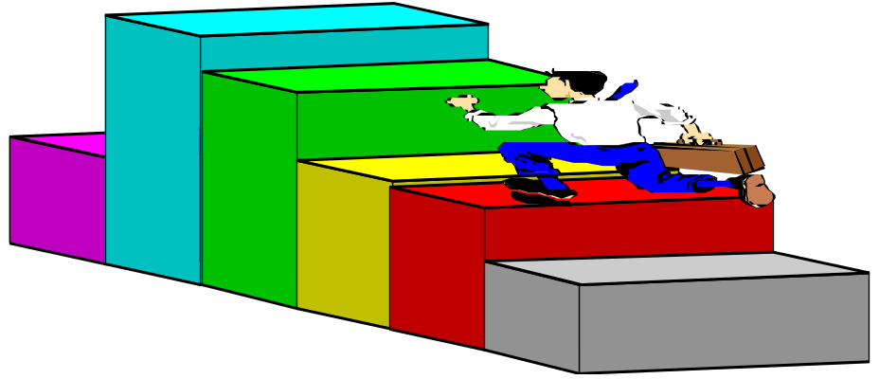
Longitudinal Data May Show Substantial Change
Brand Purchased in Period 1
Brand Purchased in Period 2
Brand A Brand B Brand C Total
Brand A
Brand B
Brand C
Total
100
25
75
200
50
100
150
300
50
175
275
500
200
300
500
1000

Slide 31
Explanatory (causal)
Explanatory (causal) is:
- to establish causal relationships between variables
- to analyze the quantitative data to prove a relationship

Slide 32
Explanatory (Causal) Research:
undertaken with the aim of identifying cause and effect relationships amongst variables
are normally preceeded by exploratory and descriptive research studies
Often difficult to determine because of the influence of other variables

Slide 33
Quantitative (Explanatory research) should be conducted when
When you want to test an hypothesis.
When there is sufficient theoretical literature that can be used to identify assumptions and construct hypotheses.
When you have enough participants to construct experimental and control groups or can reasonably conduct pre and post tests.
When you can link theories or specific actions with outcomes.

Slide 34
Uses of Causal Research
To understand which variables are the cause (independent variables) and which variables are the effect (dependent variables) of a phenomenon
To determine the nature of the relationship between the causal variables and the effect to be predicted
METHOD: Experiments

Slide 35
Alternative Research Designs
Exploratory Research
Secondary Data Analysis
Focus Groups
Conclusive Research
Descriptive/Causal
(a)
Conclusive Research
Descriptive/Causal
(b)
Conclusive Research
Descriptive/Causal
Exploratory Research
Secondary Data Analysis
Focus Groups
(c)

Slide 36
